Slide 1
Data Analysis
With Python

Slide 2
six steps for Data Analysis
Ask or Specify Data Requirements
Prepare or Collect Data
Clean and Process
Analyze
Share
Act or Report

Slide 3
Prerequisites for Data Analysis
Python For Data Analysis
SQL For Data Analysis
Python Data Visulization
Data Analysis Datasets
Notes:
https://www.geeksforgeeks.org/data-analysis-tutorial/?ref=shm

Slide 4
Data Analysis Libraries
Pandas
Numpy
Matplotlib

Slide 5
Data Analysis Tools
Excel
Tableau
Power BI

Slide 6
Python For Data Analysis
Notes:
https://www.geeksforgeeks.org/data-analysis-with-python/?ref=outind

Slide 7
Pandas
The name of Pandas is gotten from the word Board Information, and that implies an Econometrics from Multi-faceted information. It was created in 2008 by Wes McKinney and is used for data analysis in Python.
Processing, such as restructuring, cleaning, merging, etc., is necessary for data analysis. Numpy, Scipy, Cython, and Panda are just a few of the fast data processing tools available.

Slide 8
Data Structures
Series
Data Frame
import pandas as pd
import numpy as np
info = np.array(['P','a','n','d','a','s'])
a = pd.Series(info)
print(a)
import pandas as pd
x = ['Python', 'Pandas']
df = pd.DataFrame(x)
print(df)
Notes:
https://www.tpointtech.com/python-pandas-series

Slide 9
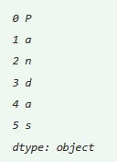
Pandas Series
<series object> = pandas.Series()
#Example
import pandas as pd
import numpy as np
info = np.array(['P','a','n','d','a','s'])
a = pd.Series(info)
print(a)

Slide 10
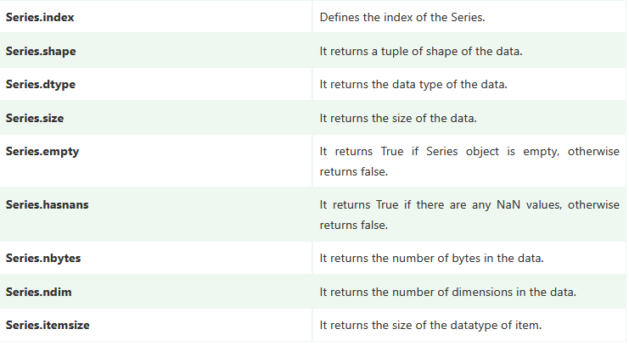
Pandas Series Attribute

Slide 11
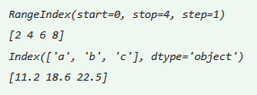
Retrieving Index array and data array
import numpy as np
import pandas as pd
x=pd.Series(data=[2,4,6,8])
y=pd.Series(data=[11.2,18.6,22.5], index=['a','b','c'])
print(x.index)
print(x.values)
print(y.index)
print(y.values)

Slide 12

Types (dtype) and Size of Type
import numpy as np
import pandas as pd
a=pd.Series(data=[1,2,3,4])
b=pd.Series(data=[4.9,8.2,5.6],
index=['x','y','z'])
print(a.dtype)
print(a.itemsize)
print(b.dtype)
print(b.itemsize)

Slide 13

Retrieving Dimension, Size and Number
import numpy as np
import pandas as pd
a=pd.Series(data=[1,2,3,4])
b=pd.Series(data=[4.9,8.2,5.6],
index=['x','y','z'])
print(a.ndim, b.ndim)
print(a.size, b.size)
print(a.nbytes, b.nbytes)

Slide 14
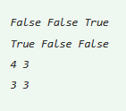
Checking Emptiness and NaNs
import numpy as np
import pandas as pd
a=pd.Series(data=[1,2,3,np.NaN])
b=pd.Series(data=[4.9,8.2,5.6],index=['x','y','z'])
c=pd.Series()
print(a.empty,b.empty,c.empty)
print(a.hasnans,b.hasnans,c.hasnans)
print(len(a),len(b))
print(a.count( ),b.count( ))

Slide 15
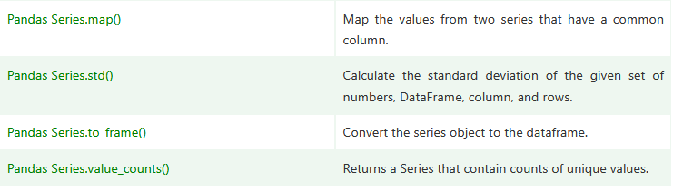
Functions
Notes:
https://www.tpointtech.com/python-pandas-series

Slide 16
SQL For Data Analysis

Slide 17
Python Data Visulization

Slide 18
Data Analysis Datasets

